Slide 1
Photo Checklist
Product photography

Slide 2
Unisex & Women’s T-shirt
“form” photo with neutral background
Product laid flat
Shirt Folded- Shows detail

Slide 3
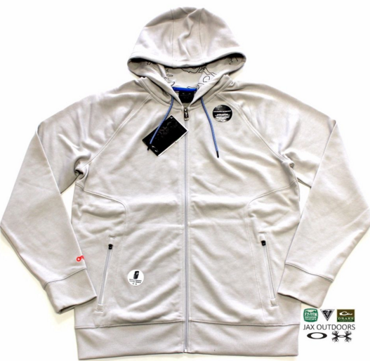
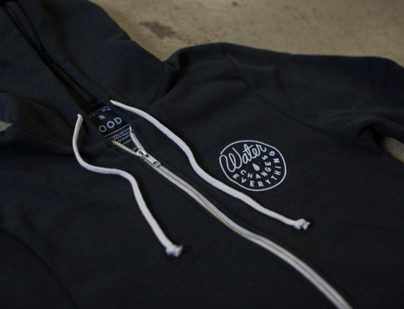
Unisex Sweatshirt
On Form
Laid Flat
Up Close Detail on graphic

Slide 4
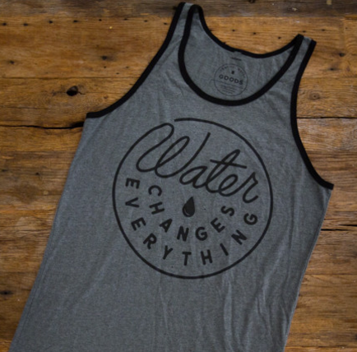
Unisex Tank and Racer Back Tank
“Form” photo with neutral background- shows front and back
Product laid flat- shows detail

Slide 5
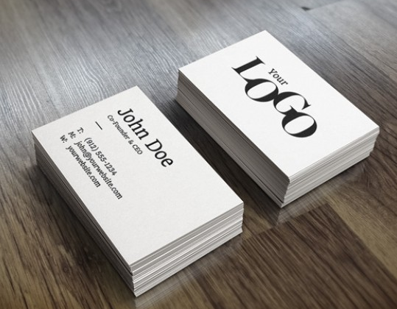
Wrist Bands and Promise Cards
Stack showing multiple wristbands/cards
Up close of wording on wristband/cards

