Slide 1
Volunteer Instructions
because I said I would

Slide 2
Thank you for volunteering your time and assistance! As a volunteer, your role will ensure that supporters can easily find and purchase merchandise, which is tremendously helpful in funding the nonprofits programs!

Slide 3
Product Organization
Merchandise will be organized by type and size for your retrieval
Retrieve size/style requested by supporter and make suggestions about other product
Familiarize yourself with product prices
Communicate product information to cashier
Bag items and any promotional materials provided to you

Slide 4
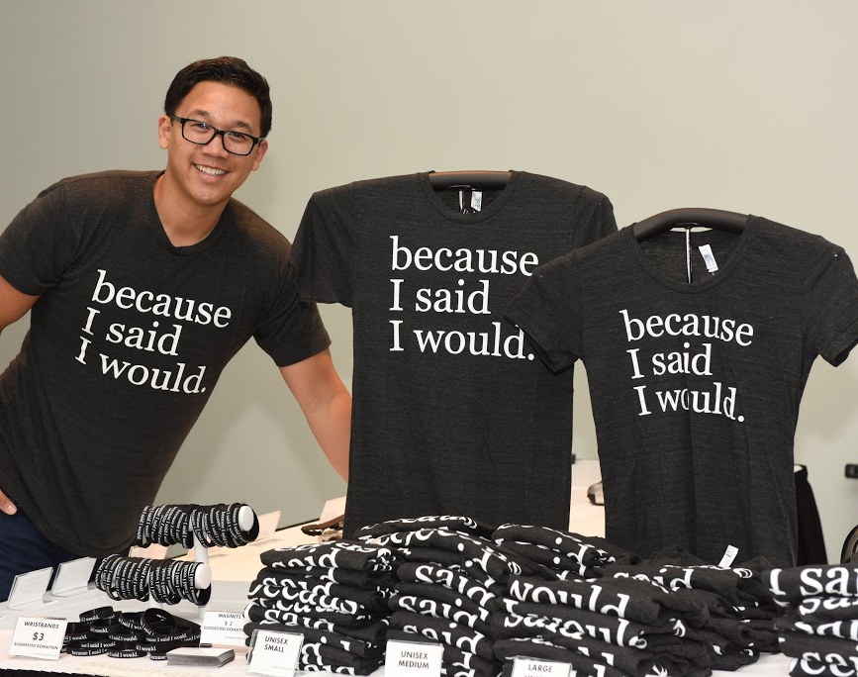
Merchandise Table Layout
Organize in stacks by style and size i.e. unisex t-shirt size large
Each style will have a suggested donation sign that can be placed in front of it
Wristbands can be displayed on white holders and on table
T-shirts can be displayed on metal display stands to show look
Stickers, magnets and non apparel items can be laid on table

Slide 5
Metal Display Stand
Use key on side to adjust height
Screw in bottom part of pole to stand
Screw in top part of pole to foam “hanger”

Slide 6
Cashier
Credit card machine will be provided to complete sales
Choose merchandise to be purchased
All transactions are DONATION based- therefore we have suggested donation amounts not set prices- which also means no tax is charged
Verify accuracy of transaction and accept payment by either cash or credit card

Slide 7
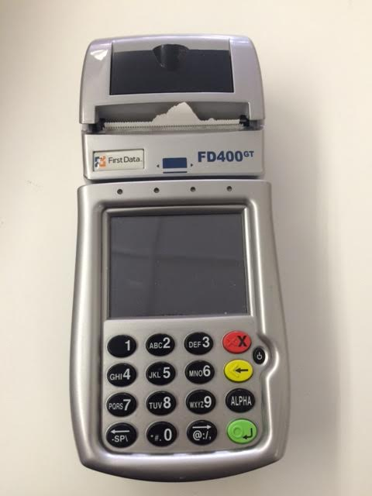
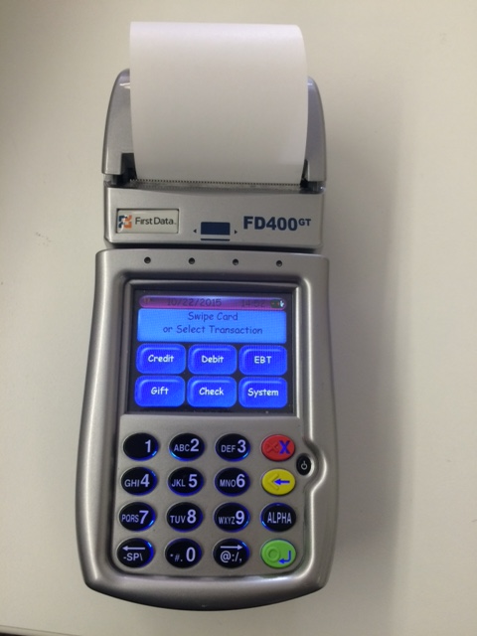
Credit Card Machine
https://www.firstdata.com/demos/terminal_demos/FD400_Demo2012.html

Slide 8
Instructions for Credit Card
Swipe Card
Key in amount of donation
Ask whether customer wants copy of receipt- if so choose yes when asked if you want a customer copy
Have customer sign merchant copy

